Slide 1
CONDITIONAL STRUCTURES
Computer Organization and Assembly Language
Computer Science Department
National University of Computer and Emerging Sciences Islamabad

Slide 2
ARITHMETIC INSTRUCTIONS
MUL operand1
  operand1 is 8-bit (type BYTE): multiply with contents placed in register AL, result will be in AX.
  operand1 is 16-bit (type WORD): multiply with contents placed in register AX, result will be in DX:AX.
  operand1 is 32-bit (type DWORD): multiply with contents placed in register DX:AX, result will be in EDX:EAX.
  Example
  MOV AL, 200 ;
  MOV BL, 4
  MUL BL ;

Slide 3
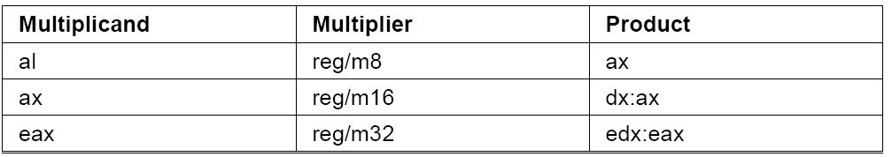
MUL INSTRUCTION

Slide 4
ARITHMETIC INSTRUCTIONS
DIV operand1
  when operand is a BYTE: AL = AX / operand then
    AL =Quotient
    AH = remainder
  Example
  MOV AX, 203;
  MOV BL, 4;
  DIV BL ; AL = 50 , AH = 3

Slide 5
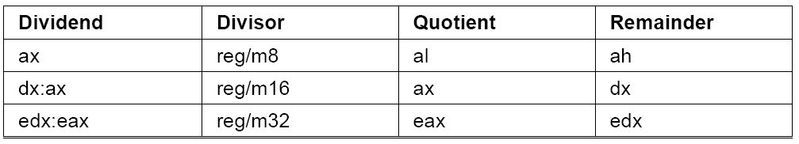
DIV INSTRUCTION
  when operand is a word: AX = (DX AX) / operand then
    AX = Quotient
    DX = remainder

Slide 6
DIVIDE OVERFLOW
If a division operand produces quotient that is larger than storage then divide overflow condition occurs and the program terminates.
  MOV AX,1000h
  MOV BL, 10h
  DIV BL ;AL cannot hold 100h
Similarly when you divide by zero program terminates.

Slide 7
LABELS IN ASSEMBLY
A label is an identifier that is followed by a colon.
Names suffixed with colons (:) are symbolic labels.
The labels do not create code.
They are simply a way to tell the assembler that those locations have symbolic names.
Example
  Label1:
  Above:
  Start:

Slide 8
JMP INSTRUCTION
Unconditional jump
Jumps to the given label[Address]
Syntax:
  JMP [Label] ;PC will jump to the address of Label

Slide 9
EXAMPLES
Backward jump
  StartLoop:
  ; statements
  JMP StartLoop
Forward jump
  JMP EndLoop
  ; statements
  EndLoop:

Slide 10
CONDITIONAL JUMPS
Transfers Control if condition is satisfied.
Jumps based on unsigned data
Jumps to label if equal
  JE [label]
Jump if not equal
  JNE [label]

Slide 11
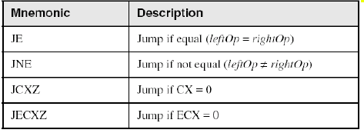
JUMPS BASED ON EQUALITY
Notes:
ZF=1
ZF=0

Slide 12
CMP INSTRUCTION
Compares value of two operands and set flags
Syntax
  CMP opr1,opr2
  Opr1 = reg/mem
  Opr2 = reg/mem/imme
Example
  CMP ax,bx
  CMP ah,al

Slide 13
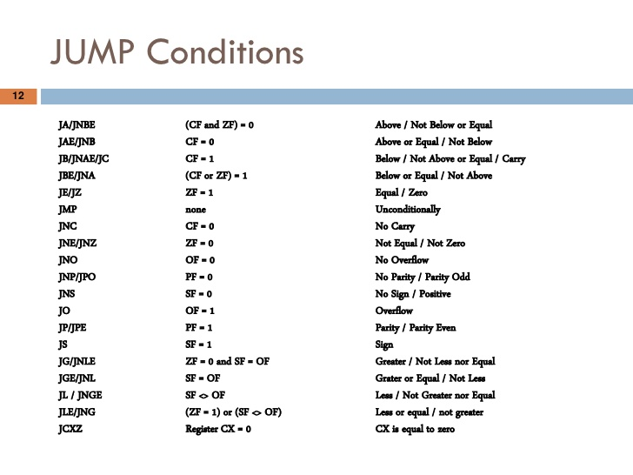
Notes:
ZF=1
ZF=0

Slide 14
Example:
    …
    Mov al,5
    Cmp al,5
    Je label1
    Jmp exit
  Label1:
    Mov ax,bx
    …
  Exit: …

Slide 15
EXECUTION OF ANOTHER EXAMPLE
;;Assembly language code
mov ax , 15
mov bx , 15
mov cx , 0
cmp ax , bx
jne lable1
mov cx , ax
jmp end
lable1:
mov cx , bx
end:
;;Assembly language code
mov ax , 15
mov bx , 10
mov cx , 0
cmp ax , bx
jne lable1
mov cx , ax
jmp end
lable1:
mov cx , bx
end:

Slide 16
LOOP INSTRUCTION
CX used as Counter
Automatically Decremented after every iteration
Label is used to jump
Ends when counter reaches zero
Example:
  MOV cx,10 ;loop runs 10 times
  Loop1:
    …
  Loop Loop1

Slide 17
POINTERS
You can declare a pointer variable that contains the offset of another variable.
.data
arrayW WORD 1000h,2000h,3000h
ptrW DWORD arrayW
.code
mov esi,ptrW
mov ax,[esi] ; AX = 1000h
Alternate format:
ptrW DWORD OFFSET arrayW

Slide 18
TWO-DIMENSIONAL ARRAYS
IA32 has two operand types which are suited to array applications
  Base-Index Operands
  Base-Index Displacement

Slide 19
BASE-INDEX OPERAND
A base-index operand adds the values of two registers (called base and index), producing an effective address. Any two 32-bit general-purpose registers may be used.
Common formats:
[ base + index ]
Base-index operands are great for accessing arrays of structures. (A structure groups together data under a single name. )

Slide 20
BASE-INDEX-DISPLACEMENT OPERAND
A base-index-displacement operand adds base and index registers to a constant, producing an effective address. Any two 32-bit general-purpose registers may be used.
Common formats:
[ base + index + displacement ]
displacement [ base + index ]

Slide 21
TWO-DIMENSIONAL TABLE EXAMPLE
Imagine a table with three rows and five columns. The data can be arranged in any format on the page:
table BYTE 10h, 20h, 30h, 40h, 50h
BYTE 60h, 70h, 80h, 90h, 0A0h
BYTE 0B0h, 0C0h, 0D0h, 0E0h, 0F0h
NumCols = 5
Alternative format:
table BYTE 10h,20h,30h,40h,50h,60h,70h,
80h,90h,0A0h,
0B0h,0C0h,0D0h,
0E0h,0F0h
NumCols = 5
Notes:
C0 C1 C2 C3 C4
R0 10h, 20h, 30h, 40h, 50h
R1 60h, 70h, 80h, 90h, 0A0h
R2 0B0h, 0C0h, 0D0h, 0E0h, 0F0h

Slide 22
STRUCTURE APPLICATION
A common application of base-index addressing has to do with addressing arrays of structures (A structure groups together data under a single name). The following defines a structure named COORD containing X and Y screen coordinates:
COORD STRUCT
X WORD ? ; offset 00
Y WORD ? ; offset 02
COORD ENDS
Then we can define an array of COORD objects:
.data
setOfCoordinates COORD 10 DUP(<>)
Notes:
Empty angle brackets < > cause the structure to contain the default field values from the structure Definition. Alternatively, you can insert new values in selected fields. The values are inserted into the structure fields in order from left to right, matching the order of the fields in the structure declaration. Examples of both approaches are shown here, using the COORD.
.data
point1 COORD <5,10> ; X = 5, Y = 10
point2 COORD <20> ; X = 20, Y = ?
point3 COORD <> ; X = ?, Y = ?

Slide 23
STRUCTURE APPLICATION
The following code loops through the array and displays each Y-coordinate:
mov ecx, 10 ;no of instances
mov ebx,OFFSET setOfCoordinates
mov esi,2 ; offset of Y value
mov eax,0
L1: mov ax,[ebx+esi]
call WriteDec
add ebx,SIZEOF COORD
loop L1

Slide 24
TWO-DIMENSIONAL TABLE EXAMPLE
The following code loads the table element stored in row 1, column 2:
RowNumber = 1
ColumnNumber = 2
mov ebx, RowSize
mov esi,ColumnNumber
mov al,table[ebx + esi]
Notes:
RowSize=NumCols * RowNumber

Slide 25
REFERENCE
Assembly Language for x86 Processors
    Sec 4.1,4.2,4.3,4.4
    Chapter#4
    Sec 10.1 (Structure Example)
    Chapter#10
      Kip R. Irvine
      7th edition

